Slide 1
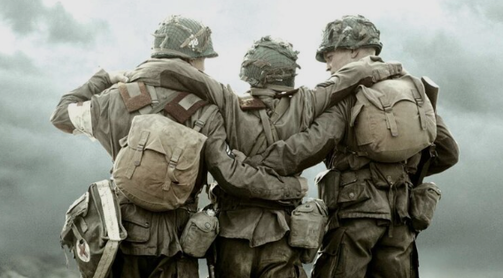

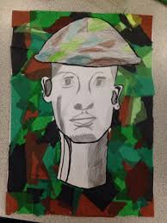
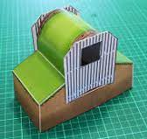
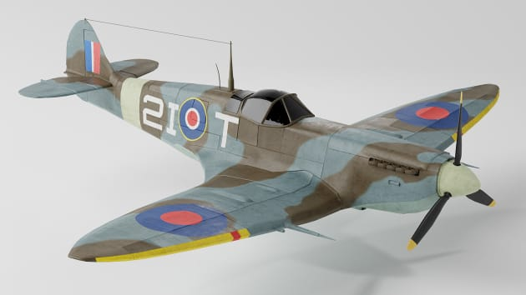
Creative Homework Menu
This term, in Y6 we will not be making creative homework compulsory due to the increase in homework in preparation for SATS. Instead, if children would like to complete creative homework we will leave this for them to choose to do so.
Here are some ideas to get you started but anything, so long as it is of a high quality, linked to local history would be great! Be Creative!
Y6 Spring Term
Create your own Blitz model
Create your own Luftwaffe
Build your own air raid shelter
Create a suitcase and belongings suitable for an evacuee or soldier
write your own newspaper report about a key event from WW2
Research information about rationing and present your ideas on PowerPoint.

Slide 2
Below is an overview of what we will be learning about this term.
Our Topic
The name of our topic this term is ‘ Their Call of Duty… Their Finest Hour’
For the first half term we will be learning all about the WW2 to answer the our over arching question ‘ How did WW2 impact modern day Britain?’. Then for the second half term, we will move on to our focus on ‘Poland’ during WW2 and focus more heavily on geography.
PE
We ask that children have their full PE kit in school at all times and must take them home to wash at weekends.
Homework
At Thorpe Hesley Primary School we have high expectations with homework and expect it to be handed in on time and to a high standard. In Year 6, this term as we move our focus to SATS, the children will now be given CGP books which focus on SAT style questions. Our expectation this term are:
Read regularly at home, at least 3 times a week. This can be filled in by children themselves but we would encourage adults at home to make a comment at least once a week
Have weekly spellings on a Friday to be completed for the following Friday.
Have set pages within CGP books. Each week children will told which book/s to complete and which page/s to complete
All children also have their own log-ins for TT Rockstars which is a great resource for practising times tables.
Thank you for your continued support.
Science | This term will be continuing our focus on ‘light’ and will begin to understand how light travels. The children will take part in various practical lessons to show this. For the second part of this term, the children will be learning all about fossils and evolution to gain a stronger knowledge about living things that inhabited the Earth millions of years ago.
History | For our focus this term, We will be focusing on our over arching question ‘How did WW2 impact modern day Britain’. They will learn about the cause of WW2, What is was like living in Britain during WW2 and learn about some of the turning points in WW2 and the consequences and benefits of this.
Geography | During Spring 2, We will move our topic focus on to ‘Poland’. From this, we will be looking at identifying allies and axis across the world during WW2. In addition, we will be looking at local geography to see how our local area was impacted during WW2.
Art | In Art, we will be experimenting a range of different materials to create different tones, textures and effects. Then the children will be learning to draw using a one-point perspectives. By the end of the topic, the children will be creating their own perspective piece that is based on a London street during WW2.
ICT | Children will be developing their word processing skills and PowerPoint, learning how to use the different features of Microsoft office through writing emails and creating posters. The children will then use these skills to create a poster or presentation all about WW2.
PE | Our focus in PE this term will be cricket and dance inspired by the war.
Music | We will be using the Charanga music scheme to learn all about pitch, tempo, rhythm, volume and timbre.
Spanish | In Spanish, we will be learning numbers up to 31 and we will be learning all about personal description and how to describe others.
RE | We will be focusing on Christianity and Islam.
PSHCE | We will be focusing on challenge and thinking about how we might come across different challenges in our life time.

